Slide 1
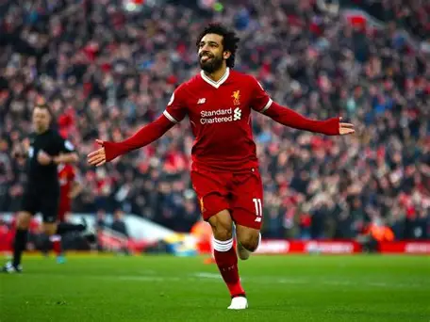

Football fixtures
Y9
2nd Oct v Tapton (Home)Win
Parkwood TBA
5th Nov - Fir Vale (Home)Win
7th Oct v Hinde House(Home)
Y10
18th Sept v Outwood (Home) Draw
9th Oct v Notre Dame (Home) Win
UTC City TBA
17th Nov v Ecclesfield (Cup - Away)Lost
Y11
25th Nov v Birley (Home) Cancelled TBA
11th Nov v Newfield (Home) Win
18th Nov v Chaucer (Home) Win
2nd Dec v King Egberts (Home)

